Slide 1
Doubleknot for Girl Scout Councils
Integrated registrations and reservations and management with support for mobile payments

Slide 2
Doubleknot for GSUSA Councils
Streamlines reservations and registration
Increase bookings and revenue
Relieves staff burden by reducing the need to answer queries, manage calendars and track missing payments and forms
Complete turnkey facilities solution! Doubleknot will provide initial configuration of all your facilities to your specifications

Slide 3

Doubleknot’s GSUSA Clients
Girl Scouts Diamonds of Arkansas,
Oklahoma and Texas
Girl Scouts Heart of the Hudson
Girl Scouts Hornets’ Nest
Girl Scouts Nations Capital
Girl Scouts North Carolina Coastal Pines
Girl Scouts of Central & Southern New Jersey
Girl Scouts of Central Illinois
Girl Scouts of Citrus
Girl Scouts of Eastern Iowa and Western Illinois
Girl Scouts of Eastern Massachusetts
Girl Scouts of Eastern Washington and
Northern Idaho
Girl Scouts of Gateway Council
Girl Scouts of Greater Iowa
Girl Scouts of Gulfcoast Florida
Girl Scouts of Historic Georgia
Girl Scouts of Kentuckiana
Girl Scouts of Michigan Shore to Shore
Girl Scouts of NE Kansas NW Missouri
Girl Scouts of North East Ohio
Girl Scouts of Northern California
Girl Scouts of Northern Illinois
Girl Scouts of Northern Indiana Michiana
Girl Scouts of Northern New Jersey
Girl Scouts of Southeastern New England
Girl Scouts of Southern Appalachians
Girl Scouts of the Chesapeake Bay
Girl Scouts of the Colonial Coast
Girl Scouts of the Jersey Shore
Girl Scouts of West Central Florida
Girl Scouts of Western Ohio
Girl Scouts San Diego
Girl Scouts Spirit of Nebraska
Girl Scouts Western Oklahoma

Slide 4
Doubleknot’s GSUSA Solutions
Event and Camp Registration
Summer camp registration
Training events
Special events and programs
Great for bridge ceremonies and other large events
Facility Reservations
Property rentals
Equipment rentals
Activities and program sites
Integrated Features
Discounts and promotions
Flexible payment options
Comprehensive email solution
Group and individual check-in
Mobile POS: Accept outstanding payments at the program site

Slide 5
Control Every Aspect of Your Facilities
General Information
Usage Schedule
  Name and category
  Description, pictures and location
  Minimum and maximum capacity
  Required ratios
  Cost per reservation
  and/or per person based on group type
    Minimum cost to rent
    (if per person)
  Collect group information?
  Blackout Periods
  By facility or overall location
  Set time and/or date for beginning and end of blackout
Type of rental period (minutes, hours, days, nights, etc.)
Allowable rental start time
  Minimum time between rentals
Check-in /check-out time
Weekday and weekend minimum and maximum rentals period
Multiple reservations allowed?
Different booking windows for in-council/out-of-council groups
“Relationships” to other facilities

Slide 6
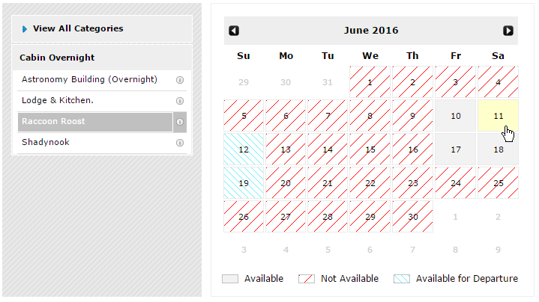
Display Facility Calendar to Visitors
Customer selects a category and facility that they’re interested in
Customer scrolls through calendar to find availability

Slide 7
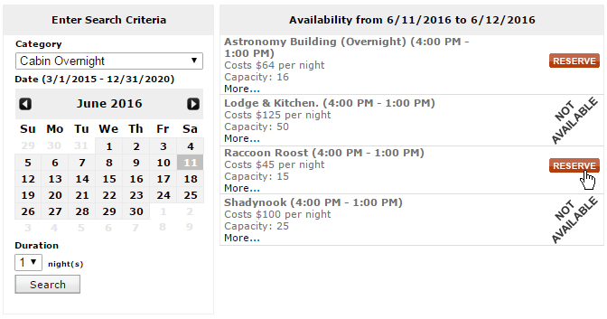
Display Facility Search to Visitors
Customer chooses criteria for date, time and/or number of participants
Facilities that match the criteria are displayed

Slide 8
Camp and Event Registration
Councils can…
Manage simple events to a complex camp programs
Choose group or individual registration for any event
  Manage capacity and waitlists (overall and by registrant type)
  Set early discounts, late fees and payment schedules
  View registration and financial data at a glance
Issue tickets for each registrant or for the entire group (great for large council-wide events)
Check-in registrants or groups
  Record attendance
  Collect outstanding payments without handling cash
  Add more people or merchandise to the registration

Slide 9

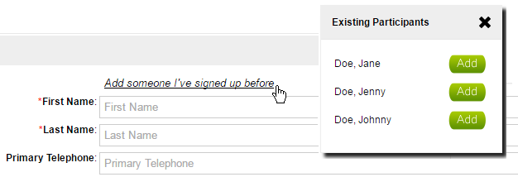
Camp and Event Registration
Registration Owners Can…
  See a current calendar or list of all upcoming events
  View number of available spaces
  Add people they’ve signed up before—no need to re-enter all group and individual information every time!

Slide 10
Integrated Doubleknot Features
Custom Forms
Offer add-ons like meal plans, patches or T-shirts for sale online during the reservation or registration process
Required forms must be completed to submit reservation
Payment Options
Online or offline payments including Cookie Dough rewards cards
Payment schedules and automatic billing reminders
Early discounts and late fees
Discount codes and promotions
Collect on-site payments with free Sales Station Mobile
Reporting and Analytics
Dozens of standard reports
Create and save custom reports
with Report Writer
Comprehensive Communications
Custom confirmations, receipts, billing reminders and tickets are sent automatically for any reservation and registration
Status reports and administrative events and facilities calendars keep property, council, troop and volunteer staff up to date
Automatically schedule email to any group or to people who match a database query

Slide 11
Event and Facility Check-in
Registrants can display print-at-home or mobile tickets
Group tickets speed check-in and reduce paper waste
Check-in registrants or groups by scan or lookup
  Automatically record attendance
  Collect outstanding payments without handling cash
  Add more people or merchandise to the registration

Slide 12
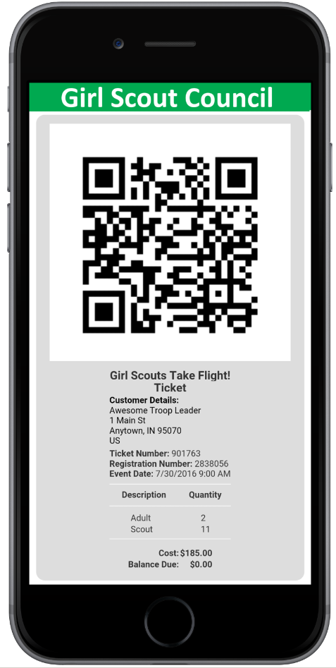
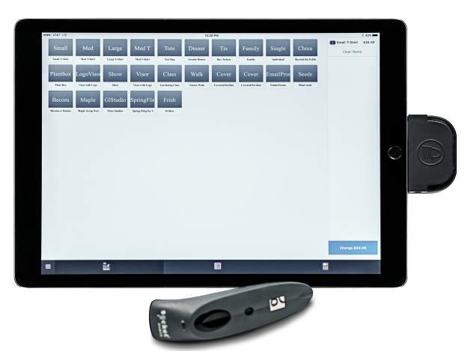
Mobile Ticket and Mobile POS

Slide 13
Services and Support
Unlimited Free Services
Initial training
Initial facilities setup
Email and telephone support
Configuration review
Interactive webinars
Add-On Custom Services
Training new staff
Setup/manage events and camps
Adding a new facility
Custom forms or payment schedules
Newsletter templates
Custom reports
Always-Available Resources
Comprehensive documentation and indexed online help
Weekly newsletter
Training video archive
Blog and Twitter

Slide 14
Demo

